Slide 1
Heart Risk Analysis
An Interactive Overview Of Factors Influencing 10 – Year Coronary Heart Disease (CHD) Risk

Slide 2
Dataset Overview
Columns in this dataset are as follow : id , age , education, sex , is_smoking , cigsPerDay , BPMeds , prevalentStroke , prevalentHyp, diabetes , totChol , sysBP , diaBP , BMI , heartrate , glucose , TenYearCHD .
Missing and null values were present in few columns which were treated using :
Mean (best for normal, continuous data without outliers)– e.g. Age , totalChol , sysBP , diaBP , heartrate.
Median (best for skewed or outlier-heavy continuous data)– e.g. cigsPerDay , BMI , glucose.
Mode (best for categorical or binary variables)– e.g. Sex , is_smoking , tenYearCHD , diabetes , BPMeds , prevalantStroke and Hyp.

Slide 3
Dataset Overview
Total Participants : 3,390
Average Age : 49 years
Gender Distribution : 56% Females , 44% Male
Smokers Distribution : 49.8% Smokers , 50.2% Non-Smokers
Average BMI : 25. 79
Average Glucose : 82 mg/dL
CHD Positive (Risk) : Approx. 15%
Medical Insight : Middle-aged individuals dominate the dataset , and most show moderate healthy profiles.

Slide 4
Column Details
PrevalentStoke and PrevalentHyp is divided into 2 groups
(Non occurring people dominate)
Diabetes was classified into 2 groups diabetic(87) and non diabetic(3303) : less people are diabetic.
Cholesterol is divided into 3 groups – High(1587) , Borderline High (1140) , Normal(663) : majority has high cholesterol.
SystolicBP is classified into 3 groups High(1715) , Normal(1015) , Elevated(660) : majority has high sysBP.
Prevalent Type | Not Occurred | Occurred
Stroke | 3368 | 22
Hypertension | 2321 | 1069

Slide 5
Column Details
DiastolicBP is classified into 2 groups high(2056) and normal(1334) : majority has high diastolic BP.
BMI is classified into 3 groups Overweight(1837) , Normal(1512) , Underweight(41) : majority is overweight.
HeartRate is classified into 3 groups Normal(2894) , Tachycardia (342) , Bradycardia(154) : majority has normal heart rate.
Glucose is classified into 3 groups Normal(3103) , Prediabetes(184) , Diabetes(103) : majority of people have normal glucose.
TenYearCHD is classified into 2 groups Positive(2879) and Negative(511) : majority of people have are positive( have risk).

Slide 6
Column Details
Age was classified into 3 groups - Adult(1402) , Middle age(1431) and Old age(557) : Middle age people dominate.
Sex was divided into 2 groups – Male(1467) and Female(1923) : Female dominate .
Is_smoking is classified into 2 groups smokers(1687) and non smokers(1703) : Non smokers dominate.
CigsPerDay was classified into 3 groups Low(2199) , Moderate(857) and High(337) : People consume low amount of cigarettes more.
BPMeds was classified into 2 groups taking(100) and not taking(3290) : Non consumers dominate.

Slide 7
Lifestyle Risk Factors
Smoking vs CHD :
Smokers show approx. 20% higher risk of CHD.
Males who smoke are the highest risk group.
2. Cigarettes Per Day :
Low (<=10) : 65% , Moderate(11-29) : 25% , High(>=30) : 25%
High smokers are more prone to have CHD tendency.
Insight : Smoking intensity correlates strongly with risk levels.

Slide 8
Health Indicators And Heart Metrics
Cholesterol :
Mean : 237 mg/dL (Borderline High Range)
2. Blood Pressure :
Mean Systolic : 132.6 mmHg , Mean Diastolic : 82.9 mmHg
3. Glucose :
Normal : 3103 , Prediabetes : 184 , Diabetes : 103
4. BMI Distribution :
Normal : 44% , Overweight : 54% , Underweight : 1%

Slide 9
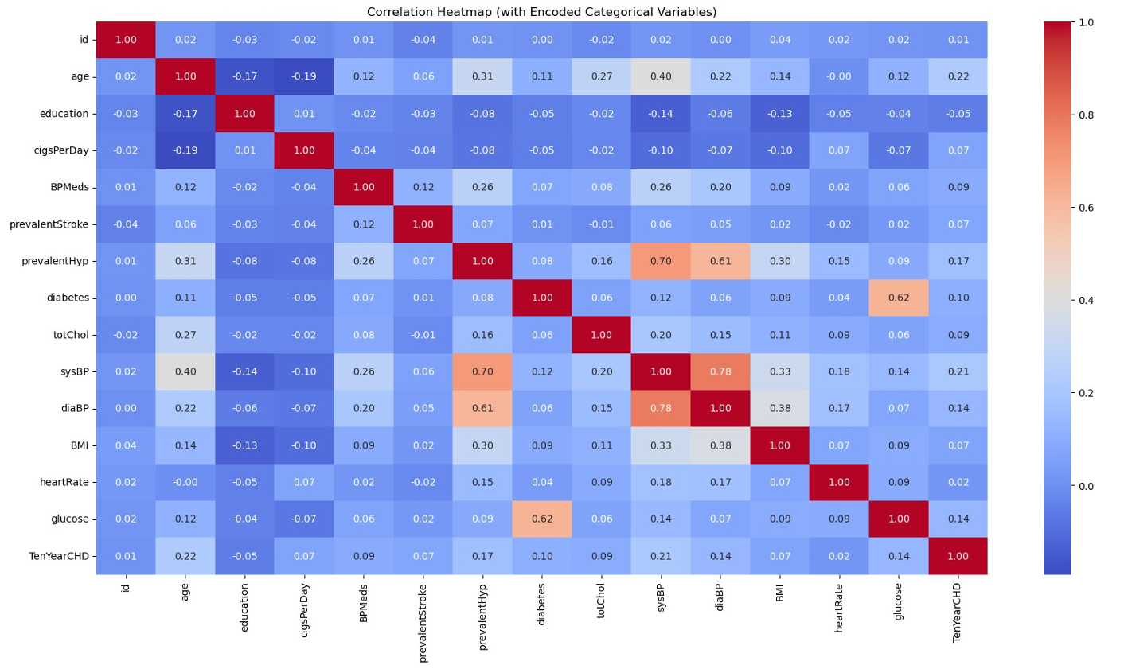
Heatmap Correlation

Slide 10
Correlation Insights
Strong positive correlation : Age and sysBP
Moderate : Smoking and CHD
Weak : BMI and CHD
The correlation heatmap shows that age and systolic BP have a strong positive relationship, indicating blood pressure increases with age.
Smoking shows a moderate correlation with CHD, while BMI has only a weak link.
Major Insight : Most variables have low-to-moderate correlations, suggesting limited multicollinearity except between age and systolic BP.

Slide 11
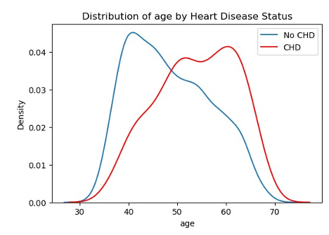
Key Visual Insights On Heart Disease Risk
Although the overall dataset has an average age of 49 years, the density curve (Red) shows that CHD cases peak around the late 50s to early 60s, which is noticeably higher than the non-CHD group.
Heart disease risk increases significantly with age, especially beyond the age of 50.
The blue curve (No CHD) shows a higher density around the 40–50 age range, indicating that people without heart disease are more commonly found in the younger segment of the dataset.
Younger individuals have a comparatively lower risk of CHD, and risk rises as age progresses.
The intersection of the two curves around age 55 represents the point at which the likelihood of having coronary heart disease becomes equal to the likelihood of not having it, marking a critical age where CHD risk begins to rise significantly.

Slide 12
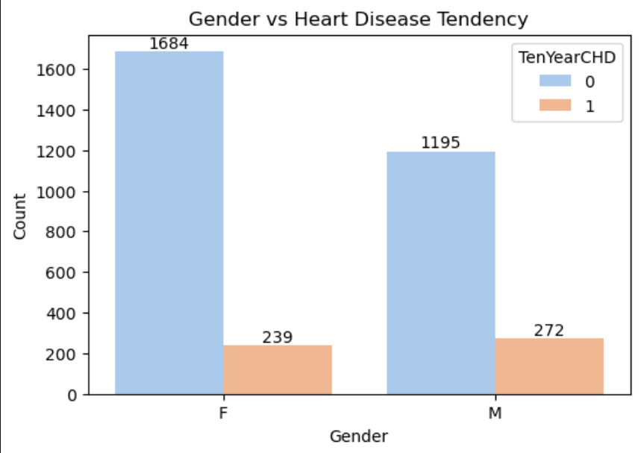
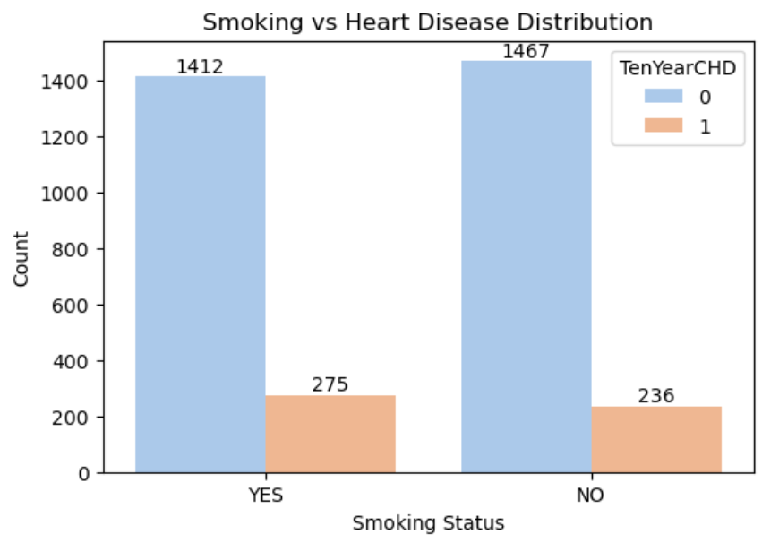
Key Visual Insights On Heart Disease Risk
Men show a greater tendency toward developing heart disease within 10 years, despite being fewer in number.
The blue bars (CHD = 0) are much taller for both genders, while risk exists, CHD events are relatively less frequent overall, especially in females.
Smokers show a higher number of 10-year CHD cases, highlighting smoking as a clear risk factor for heart disease.
Most individuals in both groups do not develop CHD, but the higher CHD count among smokers shows that smoking significantly increases risk.

Slide 13
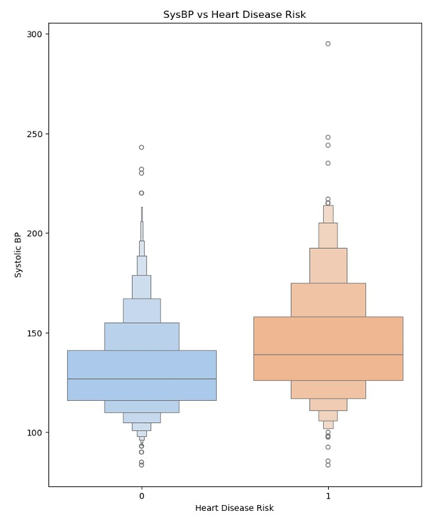
Key Visual Insights On Heart Disease Risk
Individuals with heart disease risk (CHD = 1) show a noticeably higher median systolic blood pressure than those without risk.
The CHD-positive group also has a wider spread of BP values, indicating more variation and instability.
There are many high-BP outliers in the CHD-positive category, showing the presence of severe hypertension cases.
Insight : The plot highlights that elevated and fluctuating systolic blood pressure is strongly associated with increased heart disease risk

Slide 14
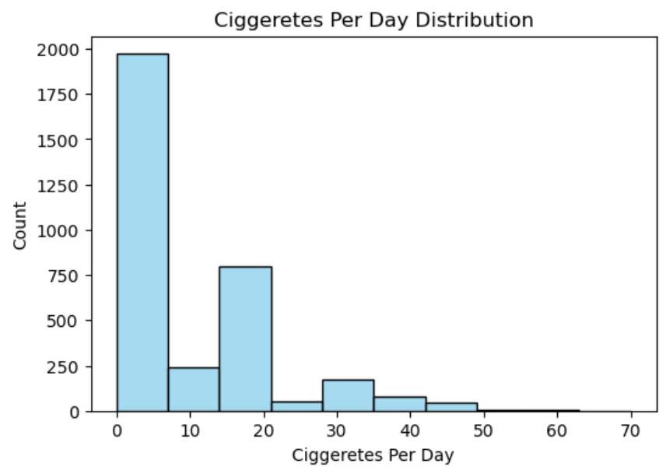
Key Visual Insights On Heart Disease Risk
The tail of the graph is towards right side so it is positively skewed.
The histogram of is_smoking shows a right-skewed distribution, with most individuals being non-smokers and fewer belonging to the smoker category.
This positive skew indicates that smoking is less common in the dataset compared to non-smoking

Slide 15
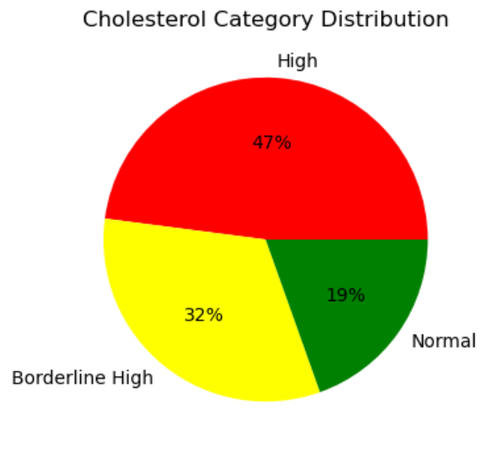
Key Visual Insights On Heart Disease Risk
The majority of individuals fall into the High Cholesterol category (47%), indicating a significant cardiovascular risk burden in the dataset.
Around 32% have Borderline High cholesterol, suggesting many individuals are close to entering the high-risk zone.
Only 19% of the population has Normal cholesterol, showing that healthy cholesterol levels are comparatively less common.
Overall, the distribution highlights a need for lifestyle interventions and preventive healthcare, as more than two-thirds of the individuals show elevated cholesterol levels.

Slide 16
Conclusion
Heart Risk Analysis Summary :
Findings highlight that managing blood pressure and reducing smoking are key to lowering long-term heart disease risk.
Age and Cholesterol are also affecting factors.
Early diagnosis is through BP and glucose monitoring is key.
Males exhibit slightly higher CHD probability.
Awareness , Preventive Actions can lower the risk of heart disease.

Slide 17





Tools Used

Slide 18
Ending
Prepared and Presented by ---
Anima Sharma
Thank you for your attention
Feel free to ask any questions

